Slide 1
Part 7 GET & POST Method
Version: 4.0.1
Written and design by: Babar ali

Slide 2
What is HTTP?
The Hypertext Transfer Protocol (HTTP) is designed to enable communications between clients and servers.
HTTP works as a request-response protocol between a client and server.
Example:
A client (browser) sends an HTTP request to the server; then the server returns a response to the client. The response contains status information about the request and may also contain the requested content.

Slide 3
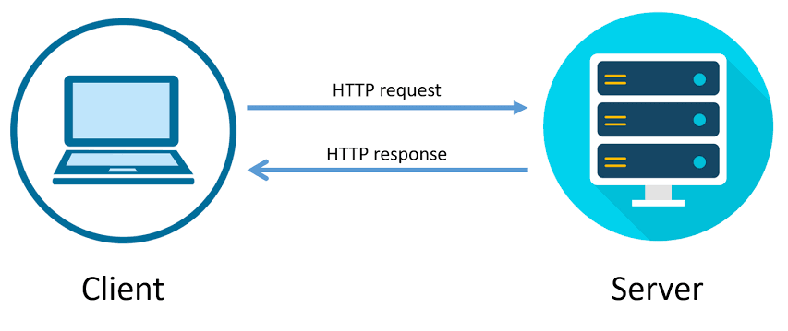
Diagram

Slide 4
What is GET Request?
GET is used to request data from a specified resource.
GET is one of the most common HTTP methods.
Note that the query string (name/value pairs) is sent in the URL of a GET request:
/test/demo_form.php?name1=value1&name2=value2

Slide 5
Some other notes on GET requests
GET requests can be cached
GET requests remain in the browser history
GET requests can be bookmarked
GET requests should never be used when dealing with sensitive data
GET requests have length restrictions
GET requests are only used to request data (not modify)

Slide 6
What is POST Request?
POST is used to send data to a server to create/update a resource.
The data sent to the server with POST is stored in the request body of the HTTP request:
POST requests are never cached
POST requests do not remain in the browser history
POST requests cannot be bookmarked
POST requests have no restrictions on data length

Slide 7
Example of GET Method in Django
my_site/first_app/urls.py
from django.http import HttpResponse
from django.shortcuts import render
def add_number(request):
num1 = request.GET['num1']
num2 = request.GET['num2']
add = int(num1) + int(num2)
print(add)
return render(request, 'add_num.html', {'answer': add})

Slide 8
Example of POST Method in Django
my_site/first_app/urls.py
from django.http import HttpResponse
from django.shortcuts import render
def add_number(request):
num1 = request.POST['num1']
num2 = request.POST['num2']
add = int(num1) + int(num2)
print(add)
return render(request, 'add_num.html', {'answer': add})

Slide 9
Thanks for Reading

